Slide 1
Sequencer Lab
John Sinclair
Kay Kasemir
Feb. 2022

Slide 2
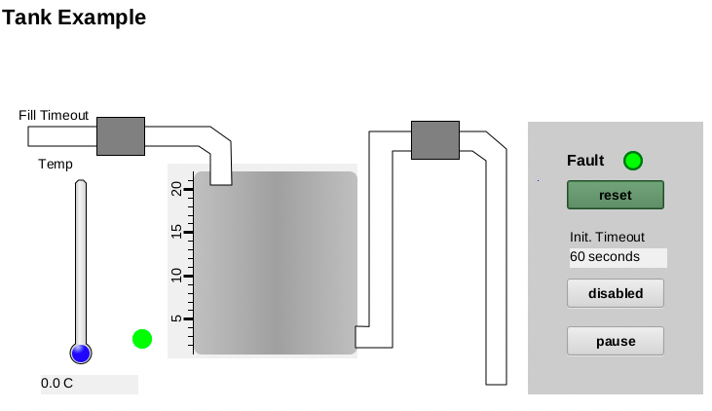
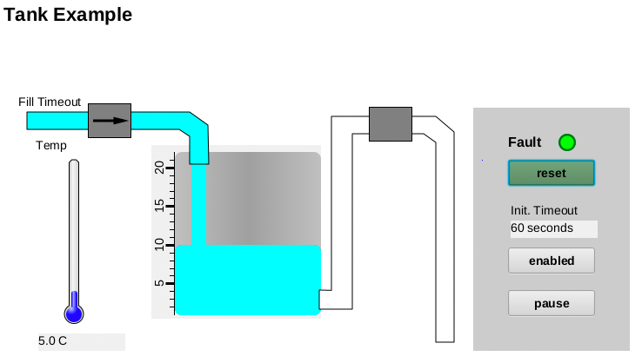
Tank Example
In CSS, open /ics/examples/14_seqApp/opi/tank.bob
In terminal, run IOC
cd /ics/examples/iocBoot/ioc_seq
./st_tank.cmd
Click “disabled” so it turns “enabled”. Tank should fill

Slide 3
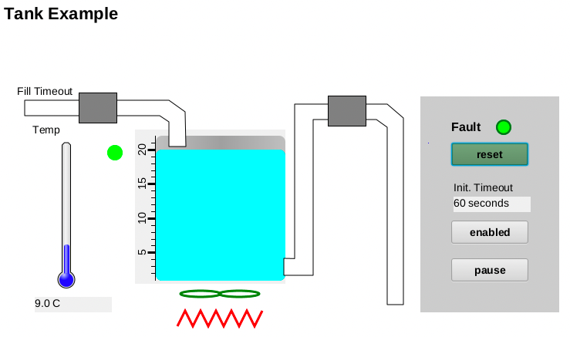
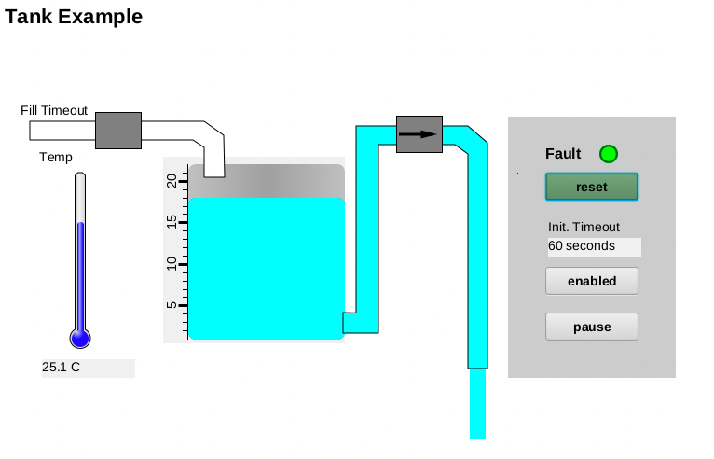
Tank Example…
When full, the tank should heat and stir
When temperature reaches 25C, tank is emptied

Slide 4
Study Database, ﻿/ics/examples/14_seqApp/Db/tank.db
Under what conditions will the “..:level” record simulate a “fill”?
.. up to what level?
What does “..:highLevel” detect?
How could you simulate a faster tank fill/drain?
.. a faster heatup?
Will anything in the database start/stop the pumps, turn the heater on/off?

Slide 5
Study SNL, ﻿/ics/examples/14_seqApp/src/tank.st
Why are some variables using “monitor”, others not?
Restart the IOC. What is the initial state?
What needs to happen to reach the “filling” state?
How to then get to the “heating” and “transferring” states?
Re-start the IOC. How do you get into the “faulted” state?
How do you then get out of the “faulted” state?
While ”filling” or “heating”, what happens when you push “pause”?
When no longer “paused”, how does the sequence know if it should return to “filling” or “heating” or …?

Slide 6
Study SNL, ﻿/ics/examples/14_seqApp/src/tank.st …
Are the pumps, heater, impeller/stirrer turned on/off
In the code that transitions into some state?
In the entry {..} section of the target state?
What’s the advantage of each approach?
Update the “transferring” state to turn everything on/off as needed within its entry {..} section

Slide 7
Update the SNL code
The original code transitions from “heating” to “transferring” when the temperature reaches 25
Add two states. Best to this one at a time!
State “holding” – hold temperature for 10 seconds
Transition to this state is from “heating”
Transition to “reheating” when complete
State “reheating” – heat until temp >= 30
Transition to “transferring” when complete

Slide 8
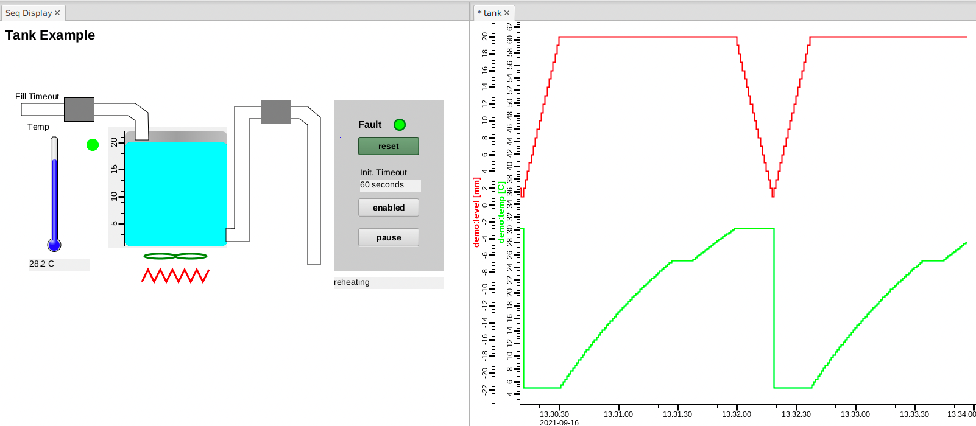
Example End Result
Temperature pauses at 25 C, then re-heats to 30

